Slide 1



Data Structure
&
Algorithm
Class IX
lab 11

Slide 2

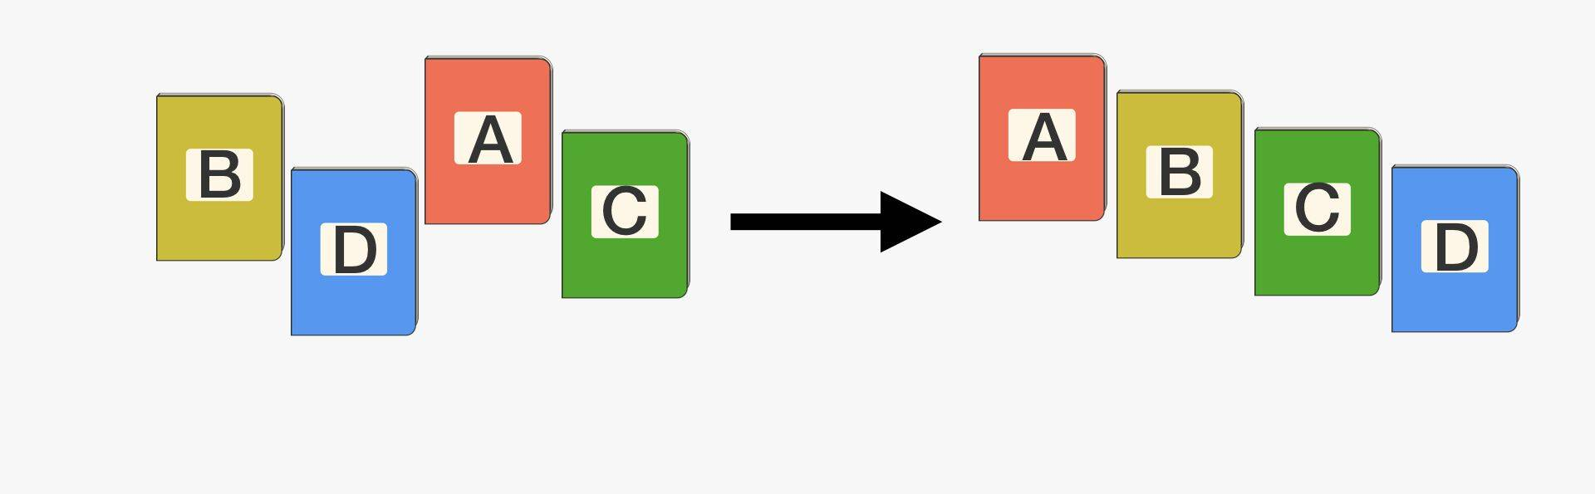
Sorting
Sorting refers to arranging data in a particular format

Slide 3

In-place Sorting
do not require any extra space

Slide 4
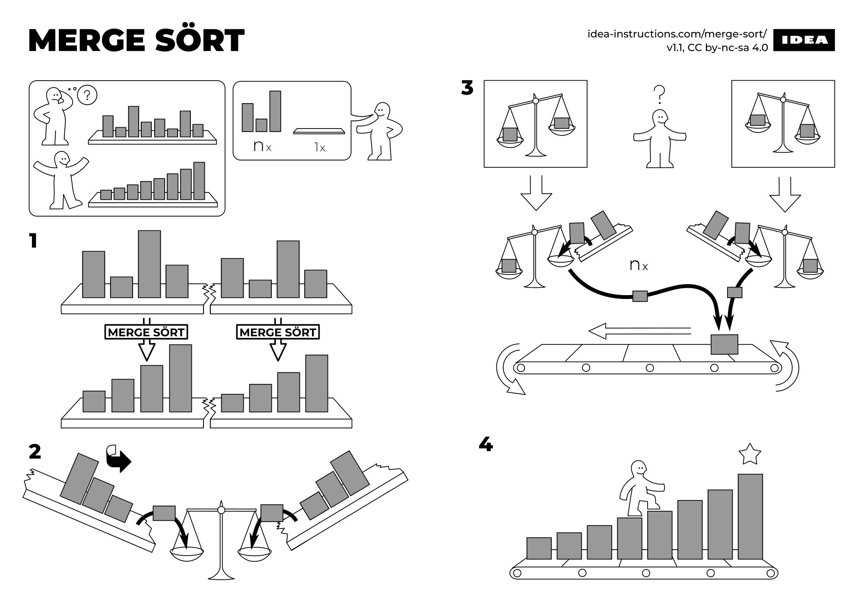
Not-in-place Sorting
extra space required

Slide 5
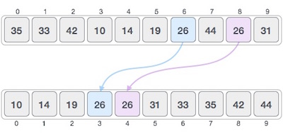
Stable Sorting

Slide 6
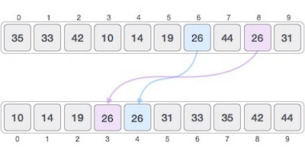
Non Stable Sorting

Slide 7
Non Stable Sorting

Slide 8


